Slide 1
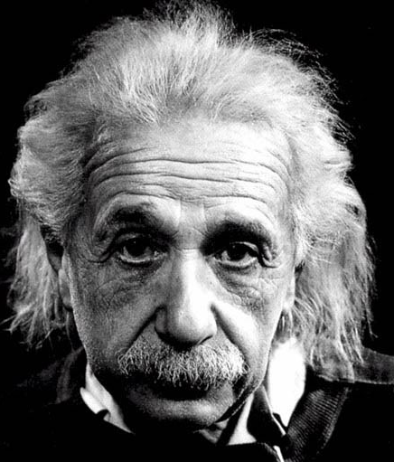
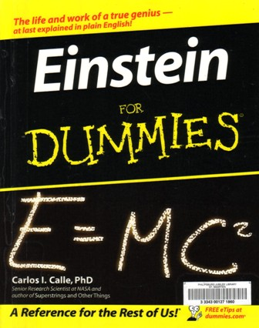
Special Theory of Relativity
A Brief introduction

Slide 2
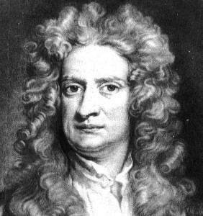
Classical Physics
At the end of the 19th century it looked as if Physics was pretty well “wrapped up”.
Newtonian mechanics and the law of Gravitation had explained how the planets moved and related that to how ordinary objects here on earth responded to forces.

Slide 3
Classical Physics (Cont)
Kinetic theory explained the behavior of gases.
Maxwell’s Theory of Electromagnetism explained the phenomena of electricity and magnetism, predicted electromagnetic waves and identified light as an example of same.

Slide 4
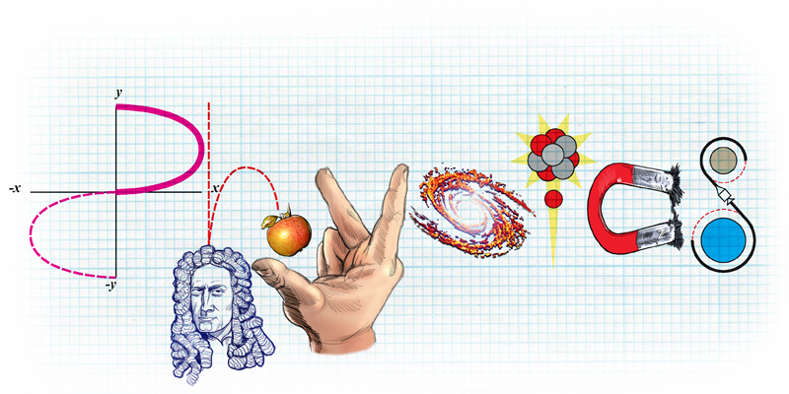
Classical Physics (Cont)
All this came to be known as classical physics.
Little did the physicist of 1900 realize what was in store during the next 100 years, when the ideas, theories, and results of modern physics were developed.

Slide 5
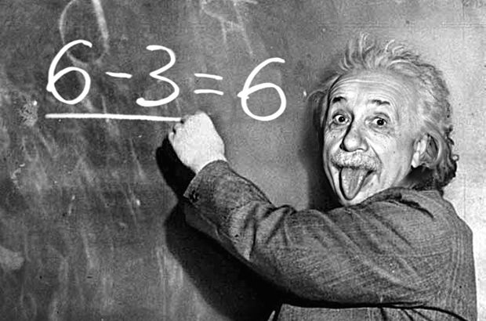
Twentieth Century Physics
Special Theory of Relativity
General Theory of Relativity
Quantum Theory

Slide 6
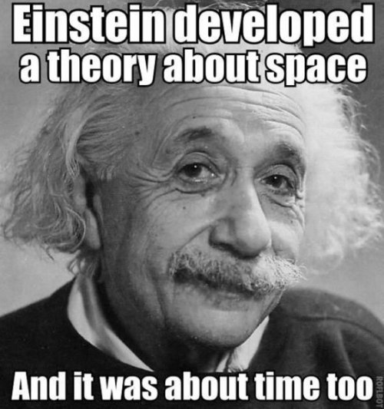
Special Theory of Relativity
Introduced a new way to view
Space
Time
Simultaneity

Slide 7
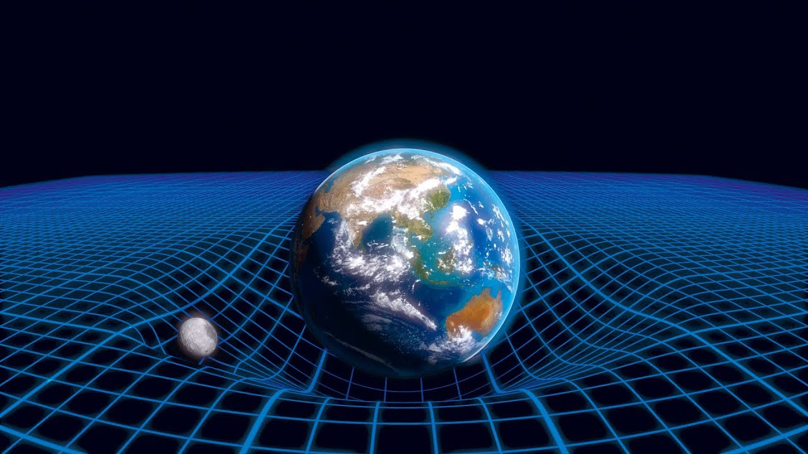
General Theory of Relativity
NOTE – Not part of the Year 12 course
This addition to special relativity, re-interpreted gravitational theory in terms of space-time.
Space-time is curved by gravity, matter, energy, and momentum.

Slide 8
Quantum Theory
Introduced a new way to think about atomic processes
Replaced “absolute knowledge” with probabilities
Helped “clear up” some problems that classical theories could not explain.

Slide 9
Galilean-Newtonian Relativity
Inertial Reference Frame
Inertial reference frames are those in which Newton’s laws of motion are valid.
Relativity Principle
The basic laws of physics are the same in all inertial reference frames.
Both understood by Galileo and Newton

Slide 10
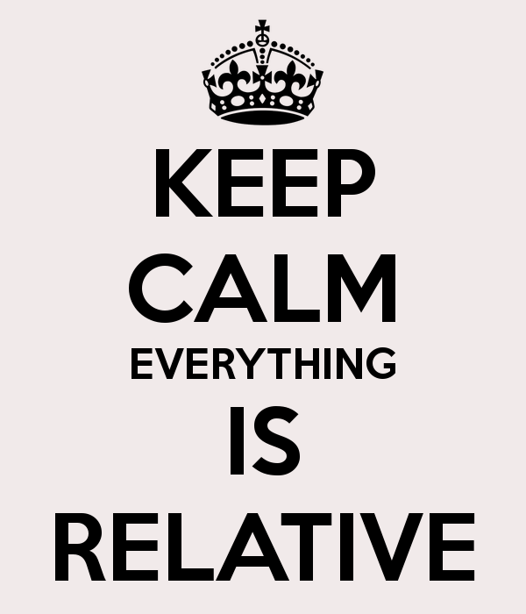

Speed
What is your current speed?
Can your feel it when you are travelling fast?
What causes day and night?
So … what is your current speed?
At the equator, the Earth rotates at
a speed of around 464 ms⁻¹
(that is about 1670 km/H!)
At Perth’s latitude it is slower at around 424 ms⁻¹

Slide 11
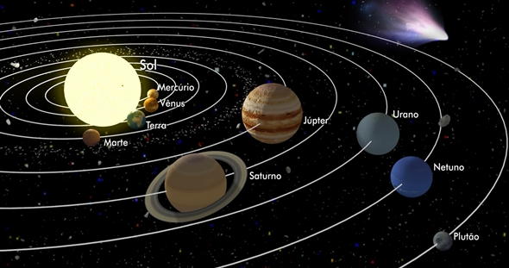
Speed – It’s all relative
What causes the seasons?
How fast is the Earth moving through space?
We orbit the sun at a speed of around 30 000 ms⁻¹ or 108 000 km/H !

Slide 12
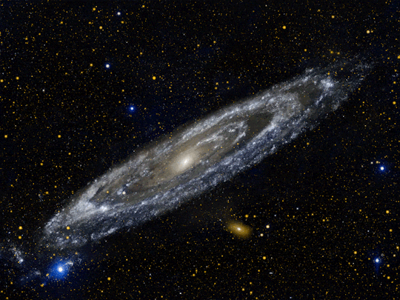
Speed – It’s all relative
The Earth is part of the Milky way spiral galaxy, which is also rotating.
How fast is our solar system moving through space?
We orbit the centres of the milky way at a speed of around 230 000 ms⁻¹ or 828,000 km/H !

Slide 13

Speed – It’s all relative
All stars in the universe are moving away from its centre, and have been since the big bang.
How fast are we moving relative to that point in space?
Around 600 000 ms⁻¹ or 0.2% of c!

Slide 14
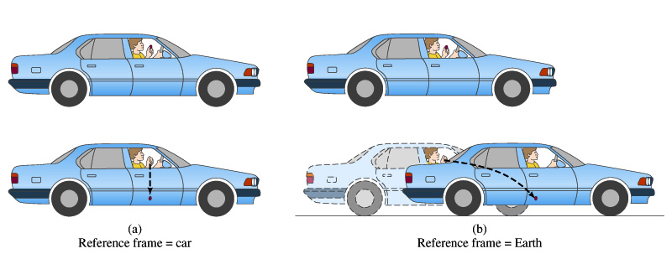
Galilean-Newtonian Relativity
Dropped object has a straight vertical path as in the car, if observed from within the car.
Parabolic path when reference frame is the earth.
The laws are the same, but the paths are different because of different initial conditions.
But both observers would agree and understand the situation.

Slide 15
Galilean-Newtonian Relativity
All inertial reference frames are equivalent for the description of mechanical motion.
There is no test or experiment you can do to “prove” which frame is really at rest or moving with constant velocity.

Slide 16
Relative Motion Calculations
A train is traveling with a speed of 17.0 m/s NORTH relative to Earth.
A passenger standing at the NORTH END of the train pitches a baseball with a speed of 15 m/s SOUTH (relative to the train)
The ball moves between the from the front of the train towards the back of the train which is 30m long.
From the perspective of the pitcher:
What is the balls displacement during this motion?
What is the balls velocity?
How long does it take the ball to hit the back of the train?

Slide 17
Relative Motion Calculations
A train is traveling with a speed of 17.0 m/s NORTH relative to Earth.
A passenger standing at the NORTH END of the train pitches a baseball with a speed of 15 m/s SOUTH (relative to the train)
The ball moves between the from the front of the train towards the back of the train which is 30m long.
From the perspective of an observer standing near the tracks as the train goes by:
What is the balls velocity?
How long does it take the ball to hit the back of the train?
What is the balls displacement during this motion?

Slide 18
Enter Maxwell and His Equations
PROBLEM! Maxwell’s theory predicts that the velocity of light is 3.00 x 10⁸ m/s and this is what is measured.
QUESTION!! In what reference frame does light have this velocity?

Slide 19
Enter Maxwell and His Equations
Maxwell’s Equations did not obey the Relativity Principle.
They were not the same in all inertial reference systems
The form of the equations changes in a moving system.
They were the simplest in a reference frame at rest.
This implied that perhaps there was a reference frame which was at absolute rest and hence the preferred reference system.
The concept of “Ether” was suggested.
Ether was a theoretical “substance” or medium permeating space through which light moved.

Slide 20
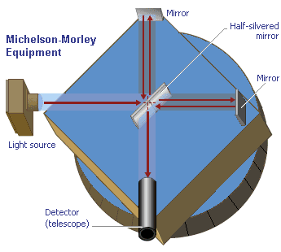
The Michelson-Morley Experiment
About a hundred years ago, a famous experiment was conducted called the Michelson-Morley experiment which measured the dependence of the speed of light on the speed of the observer.
This experiment was designed to detect the speed of the earth through the ether.
The earth’s speed around the sun is
3 x 10⁴m/s.
Predicted 0.4 fringe shift

Slide 21
The Michelson-Morley Experiment
Their apparatus was capable of measuring a shift of 0.01 fringe
NO FRINGE SHIFT WHATSOEVER was ever detected!!
To everyone's surprise, it turned out that the speed of light was always the same no matter what the motion of the observer was!

Slide 22


Slide 23
What to do?
Are Maxwell’s equations wrong?
They correctly predicted so many observations that physicists were reluctant to give them up.
Ether is “dragged” along by the earth?
Got the same results when the M&M experiment was carried out in balloons and on mountaintops.
Each attempt to determine a way to find a preferred reference system seemed to be doomed to failure

Slide 24
There is a Way Out of This Mess
This was the state of affairs in 1905 when Einstein presented his Theory of Relativity.

Slide 25
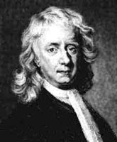
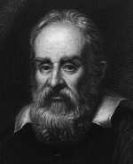
Classical Relativity
1,000,000 ms⁻¹
1,000,000 ms⁻¹
How fast is Spaceship A approaching Spaceship B?
Both Spaceships see the other approaching at 2,000,000 ms⁻¹.
This is Classical Relativity.
Notes:
V_{T} = V₁ + V₂
Mention the Ether

Slide 26
Einstein’s Special Relativity
0 ms⁻¹
300,000,000 ms⁻¹
1,000,000 ms⁻¹
Both spacemen measure the speed of the approaching ray of light.
How fast do they measure the speed of light to be?
Notes:
Moving with respect to the Ether

Slide 27
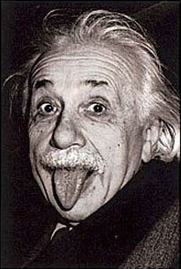
Special Relativity
Stationary man
300,000,000 ms⁻¹
Man travelling at 1,000,000 ms⁻¹
301,000,000 ms⁻¹ ?
Wrong!
Einstein said that the speed of
Light is the same for all observers.
Notes:
Mention the Michelson Morley experiment
Albert Michelson & Edward Morley
Lead Einstein to propose his Theory of Special Relativity

Slide 28
Enter Einstein - 1905
In 1905 Albert Einstein proposed that we accept the fact that the speed of light was the same in all reference systems
(this was consistent with the M&M result) and essentially lead to doing away with the concept of the ether.

Slide 29
Postulates of the Special Theory of Relativity
First Postulate: The laws of physics have the same form in all inertial reference systems. (This is the Relativity Principle)
Second Postulate: Light propagates through empty space with a definite speed “c” independent of the speed of the source or of the observer. (Agrees with experiment)

Slide 30
Special Theory of Relativity
Einstein’s theory requires giving up some long held “common sense” ideas about space and time that we have held over the centuries.
But it has the advantage that it embodies both theory (Maxwell) and experimental results (Michelson and Morley) in rejecting an absolute reference frame.

Slide 31

Time Dilation - Time Travel!
Time between ‘ticks’ = distance / speed of light
Light in the moving clock covers more distance…
…but the speed of light is constant…
…so the clock ticks slower!
Moving clocks run more slowly!
V
Notes:
Consider a clock that uses a light pulse to tick . . .

Slide 32
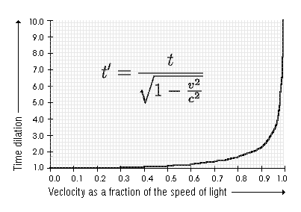

Slide 33
Special Theory of Relativity
Adopting these postulates results in losing time and space as absolute quantities.
There is no absolute space as a standard of rest (non-motion).

Slide 34

Time Dilation and Paris Hilton
Paris Hilton is worried about Einstein’s relativity theory.
The hotel heiress is one of 157 people to have already paid a $200,000 deposit for a seat on Richard Branson’s Virgin Galactic commercial space-flight service, but confessed to being “very scared” that if the spaceship flies too fast, its passengers will experience relativity’s predicted distortion in the passage of time.
“With the whole ‘light-years’ thing, what if I come back …like..10,000 years later and everyone I know is dead?” said Hilton.
“I’ll be like, ‘Great. Now I have to start all over.’”

Slide 35
A Thought Experiment
Imagine that you are sitting in a train facing forwards. The train is moving at the speed of light.
You hold up a mirror in front of you, at arm’s length. Will you be able to see your reflection in the mirror?

Slide 36
Possible Solution One
No, the reflection will not appear.
This is the result predicted by the ether model, since light can only travel at a set speed (3 × 10⁸ m s⁻¹) through the ether.
If the train is travelling at that speed then the light cannot catch the mirror to return as a reflection.
Unfortunately, this violates the general principle of relativity, which states that in an inertial frame of reference you cannot perform any experiment to tell that you are moving.

Slide 37
Possible Solution Two
Yes, the reflection will be seen.
According to the principle of relativity, it would not be possible for the person in the train to do anything to detect the constant motion with which he or she is travelling.
However, a person watching this from the side of the track should see the light from your face travelling at twice its normal speed!

Slide 38
Einstein's Solution
Einstein decided that:
the reflection will be seen as normal, because he believed that the principle of relativity should always hold true
the person at the side of the track sees the light travelling normally.
BUT, this means that time passes differently for you on the train and for the person at the side of the track

